Slide 1

Marketing Plan
May 2020
Notes:
– sprout means also “to grow”, “to rise”, “to develop”, what marks the future of company or individual person chooses brand. It can “grow”, so “develop” and make it better. It has also literal meaning – plants which grow by company Sprout grown in an ecological and environmentally friendly way.

Slide 2
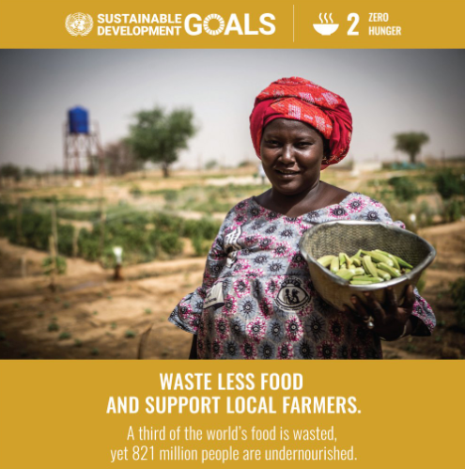
What is Sprout?
Focus on social change
Vision:
Transform how we grow, share, and consume our food.
Mission:
Create a mutually beneficial relationship between local farmers, customers, and the environment through fair exchange and shared farm experience.
Notes:
Megatrend

Slide 3
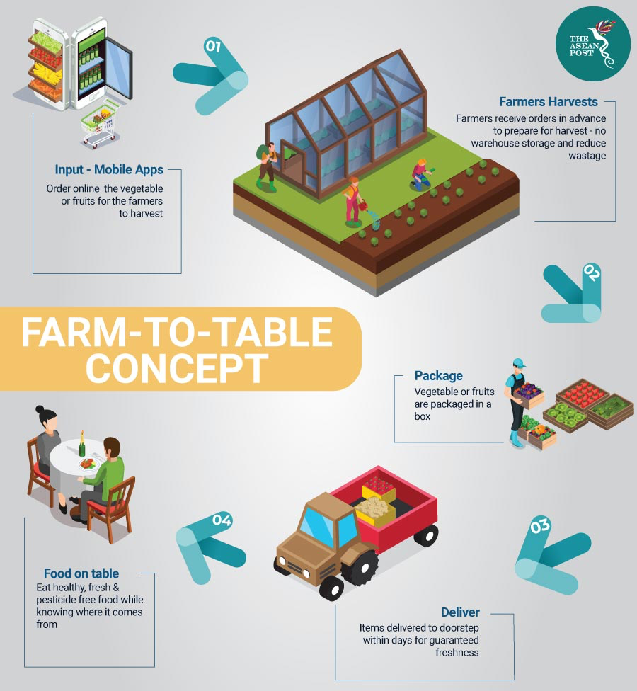

Notes:
mention visit to the product

Slide 4
Qualitative Market Research
CUSTOMERS
SUPPLIERS
COMPETITORS
20% of Spain’s total gross domestic product (GDP) comes from Catalonia.
Previous research on organic foods market show favorable attitudes toward organic foods in age groups of 18-25 and 26-35 years.
Amount of operators in Catalonia
Activity Type | Rank
Primary | 4th
Secondary | 1st
Tertiary | 1st
Services provided:
Seasonal products
Food baskets
Different sizes
Limited changes
Home delivery
Weekly
Charges for delivery
Contact with suppliers:
Home Delivery
Availability in supermarkets
Notes:
Customer age group: https://www.researchgate.net/publication/265969293_Consumer_segments_in_organic_foods_market
Catalonia GDP: https://www.cnbc.com/2017/09/21/heres-how-bad-economically-a-spain-catalonia-split-could-really-be.html
Spain’s Ministry of Agriculture: https://www.mapa.gob.es/es/alimentacion/temas/produccion-ecologica/estadisticaspe2018_tcm30-513741.pdf
Primary -> Extraction of raw materials. Secondary -> Manufacturing. Tertiary -> Services
cities for expansion

Slide 5
Quantitative Market Research
Key Findings:
Shopping Habit:
85% get their groceries from supermarkets, but 70% would consider buying online.
59% buys groceries once a week
Respondents use more recyclable materials (4.2/5)
Organic Food:
Respondents are less likely to go out of their way to get organic food, but they will consume more if they are more available (3.9/5)
Interest in Farm Visit:
Female 21-25 age group (7.2/10)
Female 26-30 age group (7.6/10)
Notes:
75 respondents, 87% age group 21 - 30, balanced split of gender
a lot of people said they will use more recyclable materials

Slide 6
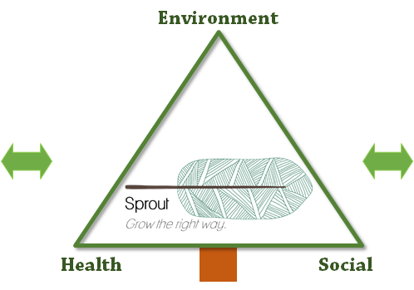
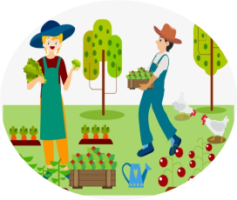
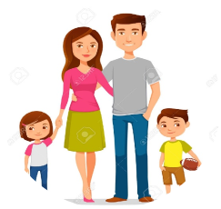
Strategic Marketing: Sprout Experience
Farms in Barcelona
Many farms within 150km
Good distribution channels
Variety of products
Customers
Age 18-25: Care for health , environment and experience
Age 25-35: Bigger tickets
Prone to use online channel.
😀 Social, environmental and healthy brand → Sprout
😀 Start as a niche and grow the right way with customers and farmers
Notes:
150km: It’s possible for users to visit.
Turn into a start competitor

Slide 7
Product
Cereals | 59,414 Ha
Leguminous for grains | 3,056 Ha
Fodder | 32,760 Ha
Tubers | 289 Ha
Vegetables | 3,028 Ha
Fresh fruits | 1,114 Ha
Dry fruits | 753 Ha
Vines | 21,083 Ha
Olives | 2,837 Ha
Customized baskets:
Baskets of fresh products with minimum weight 5kg for delivery.
The product selection is done by the customer.
Product will be packed with recyclable and eco friendly materials.
Product diversity will depend of the product seasonality.
Shops we collaborate:
In our platform, the customers will find all the information they need about the nearby shops we are collaborating.
Notes:
https://organic-market.info/news-in-brief-and-reports-article/spain-catalonia-is-the-organic-hub.html

Slide 8
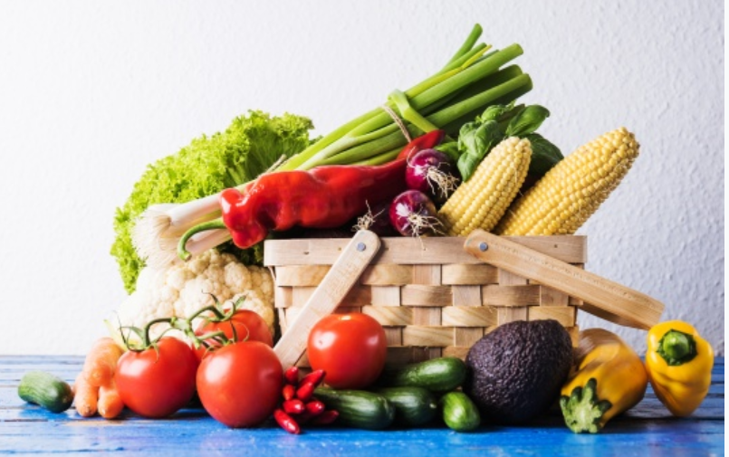
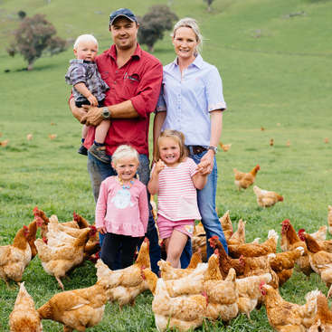
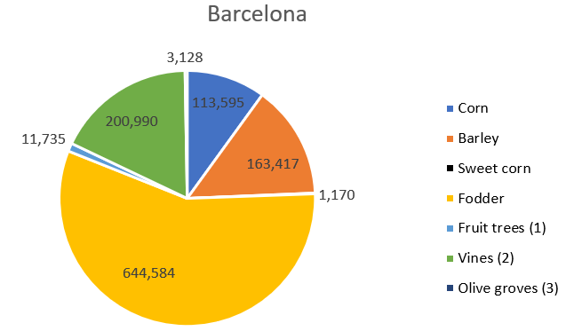
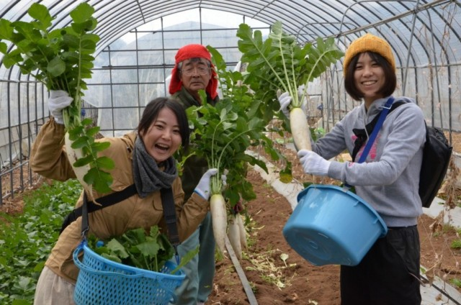
Products
Baskets of fresh products
Farming experience
Notes:
https://www.idescat.cat/pub/?id=aec&n=444&lang=en
In Sprout, we offer 2 main products,
overview of what kinds of crop growing in Spain. This is not a complete list
also depends on the farms and the seasons
Customized baskets:
The product selection is done by the customer or pre-customized by us
Of course, to be environment friendly, products will be packed with recyclable and eco friendly materials.
The minimum weight for delivery is 5kg
----------------
FE makes us stand out from our competitors
Farming experience: Nowadays, the word “organic” has been overused and sometime you dont believe in what you heard or read,
With Sprout, People can experience being a part of farming process (planting/harvesting)
They can ask questions regarding the products and farming processes.
Educational activities will be held to for kids.
The lunch prepared with farm’s products will be served for them (towards a payment).
They can buy cheaper products during their visit.

Slide 9
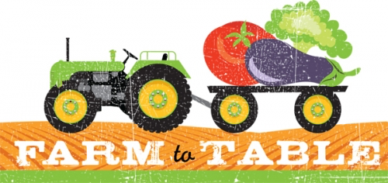
Place
Type of distribution: Indirect Distribution & Selective Distribution
3 possible distribution channels:
On our Website/Mobile app
On the “open-day”
Flea Market every weekend
Delivery once a week
Have agreements with drivers who already had a truck
No warehouse
Notes:
According to the quantitative analysis, almost 60% of Respondents goes buying groceries once a week
By doing this, products are delivered directly from the farms to the customers, which saves the cost of Keeping the foods fresh,
Minimize the cost of transportation

Slide 10
Price
Strategy: Commission-based + Subscription-based
Price Range
PRODUCT | DESCRIPTION | PRICE
Subscription | VIP subscription to Sprout | 15€
Farming Experience | Visit to local farms: Lunch and farming activities Buy products from source | 15€ - 25€ (Free for VIP customers)
Organic Baskets | Smallest basket: 5 kg | 15€ - 20€ (“Smart” pricing)
Customer
Place Order
Free delivery on purchases over 30€
VIP*
Special discounts (visits and baskets)
Free delivery & Store credit for all purchases
*Paid subscription. Customers obtain a loyalty card to manage store credit.
Notes:
Sprout’s income comes from the commission from the product which was sold and the subscription fee
“Smart” pricing: suggests the price to the farms to remain competitive in the market, which helps farmers make more profit.

Slide 11


Promotion
ONLINE MARKETING
Facebook/Instagram Advertising
Youtube video series
Media publication
Meet-Up groups
INFLUENCERS
Vlog of farm visits
IN-APP PROMOTION
Vouchers
Branding-related discount
Notes:
Facebook ads
https://www.farmingismagic.co.uk/films/
e.g. discount on Earth Day
Use multiple strategies to reach to a wide range of customers, target the right customer with the right products and make them become our loyal customers, which is our ultimate goal.

Slide 12
Promotion
Online Marketing:
Facebook Ads
Youtube video series of farmers (???)
Employ Influencers:
vlog of visit to farms
Branding-related promotion:
Earth Day promotion
Discount on products for farm visits
Reactions after covid19: sanitary conditions. Not underestimate the capacity of humans to be scared about these issues/alarms. We also take care of this.
Notes:
Facebook ads
Recommendation system -> target right person with the right products
https://www.farmingismagic.co.uk/films/

Slide 13
Thank you!
Notes:
Facebook ads

Slide 14
Forecast (Optional)
Sales and Market Share forecast for first two years
Scalability/Expansion. How often? Every 6 months? Number of farms nearby. Where would you like to expand? Maybe share warehouse in order to expand. Time of expansion (which cities)

Slide 15
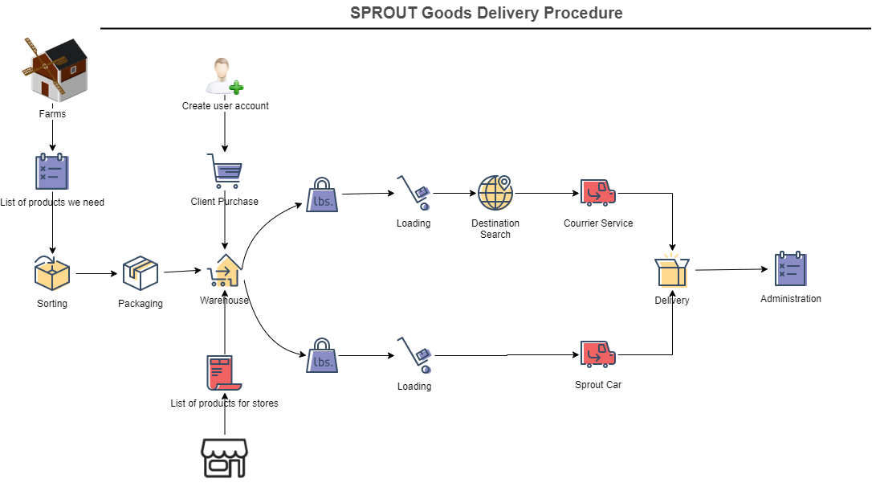

Slide 16
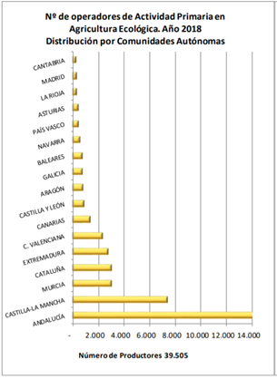
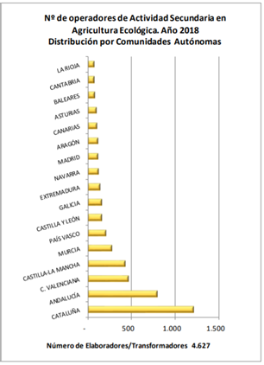
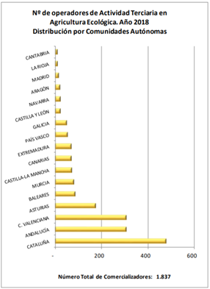
Amount of operators in Spain
Notes:
Primary -> Extraction of raw materials. Secondary -> Manufacturing. Tertiary -> Services

Slide 17
Notes:
150km: It’s possible for users to visit.
Turn into a start competitor

